Slide 1
Linux Systems and Open Source Software Robot Operating System (ROS)
Chia-Heng Tu
Dept. of Computer Science and Information Engineering
National Cheng Kung University
Fall 2024

Slide 2
Lab
Core ROS Tutorials (ROS1) (ROS2)
Installing and Configuring Your ROS Environment
Creating a ROS Package
Building a ROS Package
Writing a Simple Publisher and Subscriber (Python)
Examining the Simple Publisher and Subscriber
rqt_graph

Slide 3
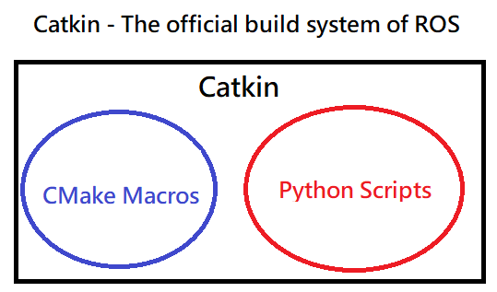
Catkin
此頁到第12頁為ROS1的操作過程，使用ROS2的同學請跳到第13頁
http://wiki.ros.org/catkin/conceptual_overview

Slide 4
Create a ROS Workspace
$ mkdir -p ~/catkin_ws/src
$ cd ~/catkin_ws/
$ catkin_make

Slide 5
Creating a catkin Package
$ cd ~/catkin_ws/src
$ catkin_create_pkg beginner_tutorials std_msgs rospy roscpp

Slide 6
Building a catkin workspace and sourcing the setup file
$ cd ~/catkin_ws
$ catkin_make
$ . ~/catkin_ws/devel/setup.bash

Slide 7
package dependencies
$ roscd beginner_tutorials
$ cat package.xml

Slide 8
Download the code from github
$ roscd beginner_tutorials
$ mkdir scripts
$ cd scripts/
$ wget https://raw.github.com/ros/ros_tutorials/kinetic-devel/rospy_tutorials/001_talker_listener/talker.py
$ wget https://raw.github.com/ros/ros_tutorials/kinetic-devel/rospy_tutorials/001_talker_listener/listener.py
$ chmod +x *.py

Slide 9
Building your nodes
$ cd ~/catkin_ws
$ catkin_make

Slide 10
Examining the Simple Publisher and Subscriber in four terminals
$ roscore
$ rosparam set enable_statistics true
$ cd ~/catkin_ws
$ source ./devel/setup.bash
$ rosrun beginner_tutorials talker.py
$ cd ~/catkin_ws
$ source ./devel/setup.bash
$ rosrun beginner_tutorials listener.py
$ rqt_graph

Slide 11
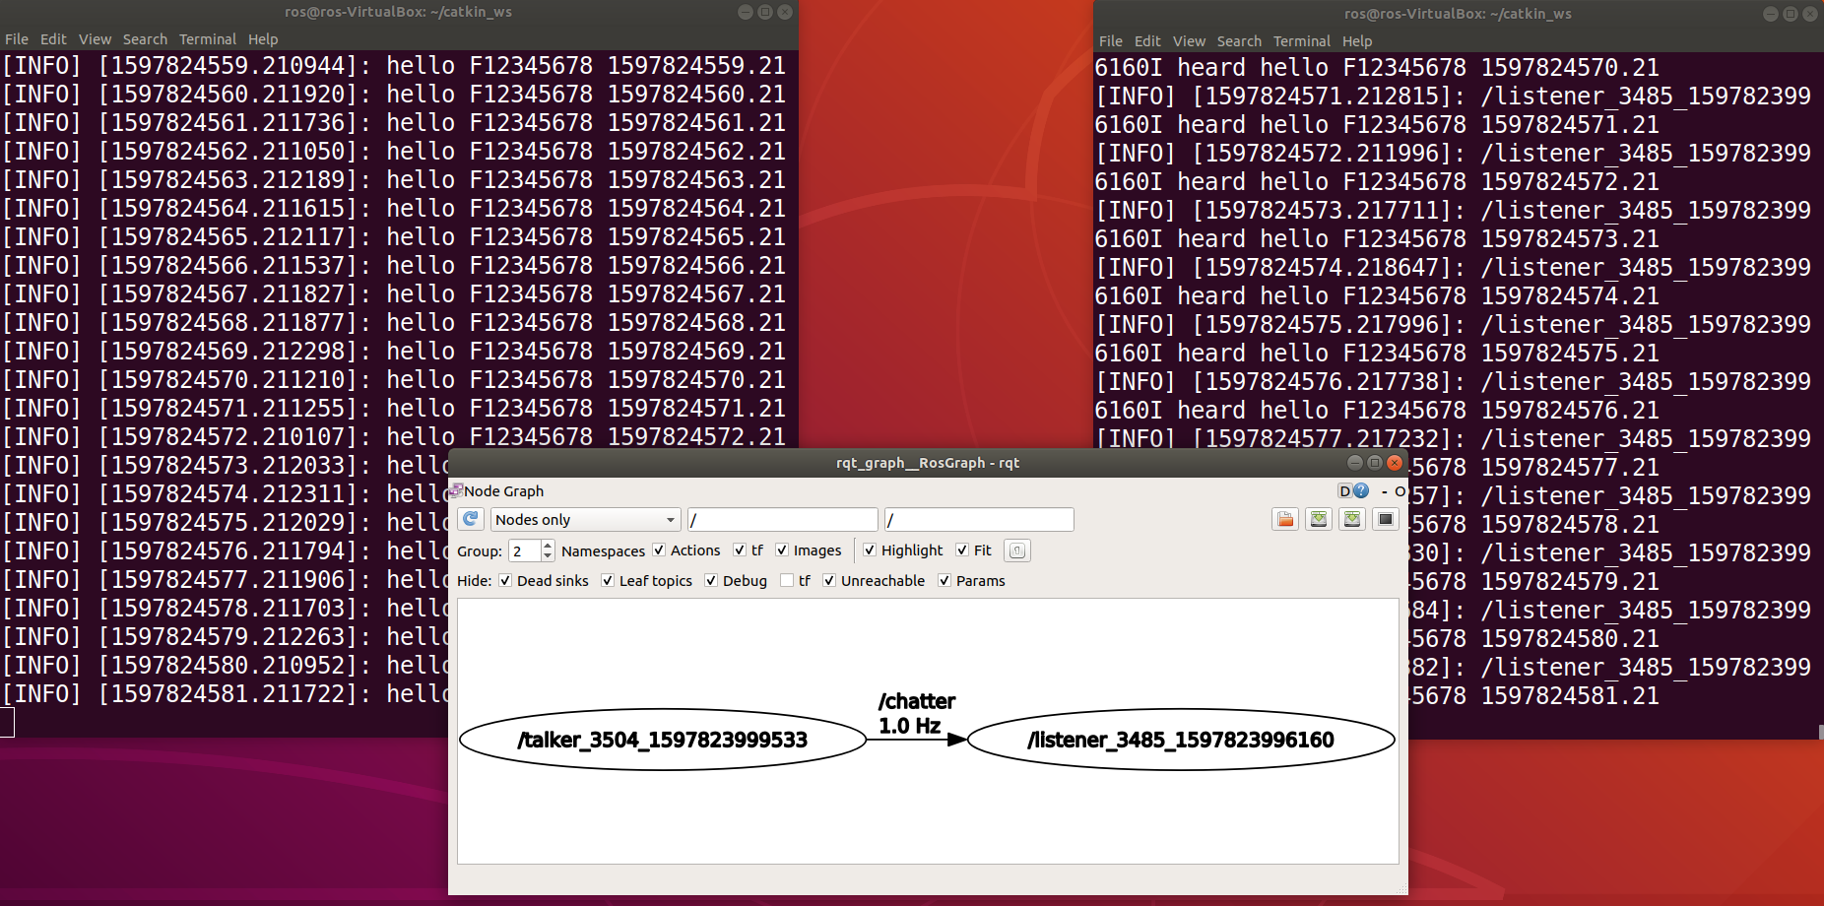
Demo
截圖須包含以下兩項檢查項目
1. Put your Student ID as the message
2. Change the data rate to 1Hz

Slide 12
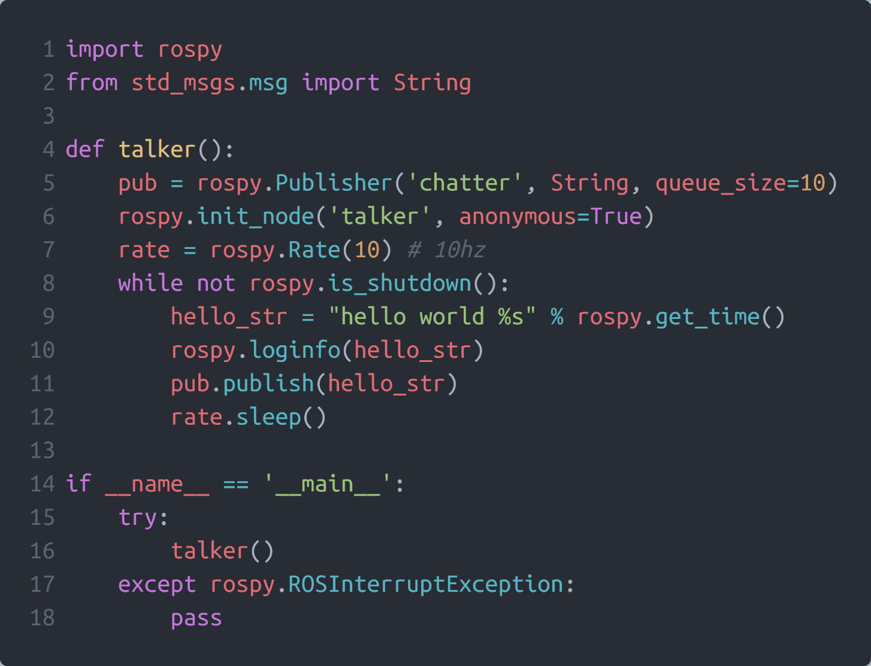
Hint: Modify “talker.py”

Slide 13
Create a ROS2 Workspace
此頁到第22頁為ROS2的操作過程，使用ROS1的同學請跳到第3頁
$ source /opt/ros/humble/setup.bash
$ mkdir -p ~/ros2_ws/src

Slide 14
Creating a Package
$ cd ~/ros2_ws/src
$ ros2 pkg create –build-type ament_python –license Apache-2.0 beginner_tutorials

Slide 15
Download the code from github
$ cd ~/ros2_ws/src/beginner_tutorials/beginner_tutorials
$ wget https://raw.githubusercontent.com/ros2/examples/humble/rclpy/topics/minimal_publisher/examples_rclpy_minimal_publisher/publisher_member_function.py
$ wget https://raw.githubusercontent.com/ros2/examples/humble/rclpy/topics/minimal_subscriber/examples_rclpy_minimal_subscriber/subscriber_member_function.py

Slide 16
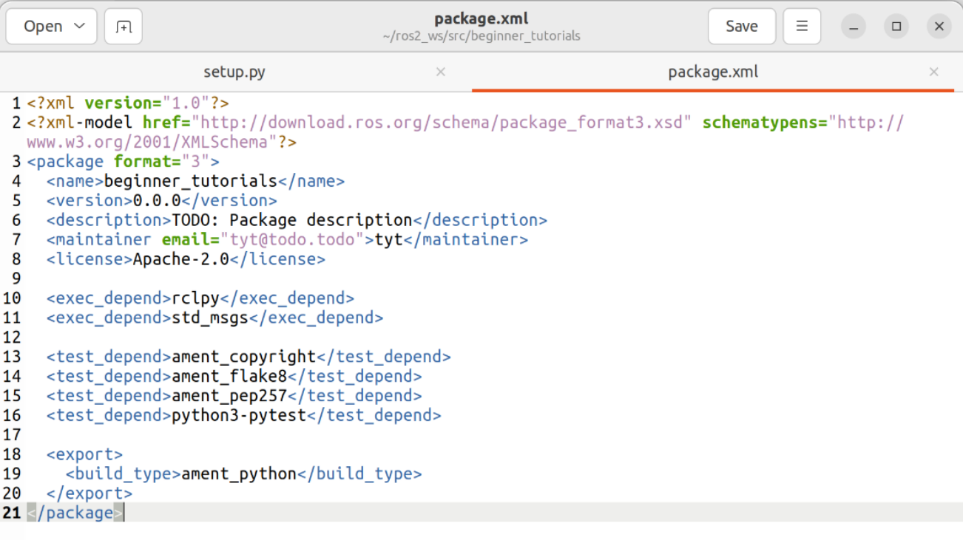
Add dependencies
Modify the ‘package.xml’
$ cd ~/ros2_ws/beginner_tutorials

Slide 17
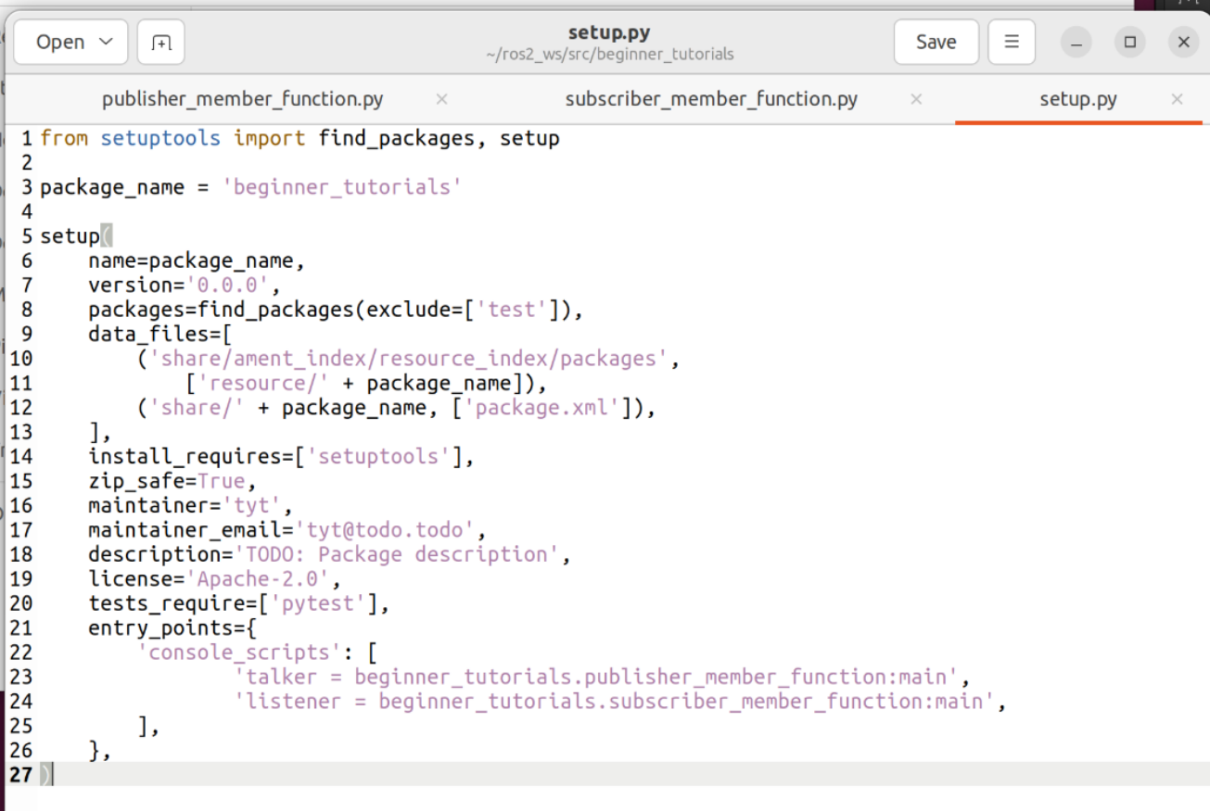
Add entry points
Modify the ‘setup.py’
$ cd ~/ros2_ws/beginner_tutorials

Slide 18
Building your nodes
$ rosdep install -i --from-path src --rosdistro humble –y
$ colcon build --packages-select beginner_tutorials
$ source install/setup.bash
Hint: sudo apt install python3-colcon-common-extensions

Slide 19
Examining the Simple Publisher and Subscriber in three terminals
$ cd ~/ros2_ws
$ source install/setup.bash
$ ros2 run beginner_tutorials listener
$ cd ~/ros2_ws
$ source install/setup.bash
$ ros2 run beginner_tutorials talker
$ cd ~/ros2_ws
$ source install/setup.bash
$ rqt

Slide 20
Setting rqt graph
Plugins -> Introspection -> Node Graph
Plugins -> Topics -> Topic Monitor

Slide 21
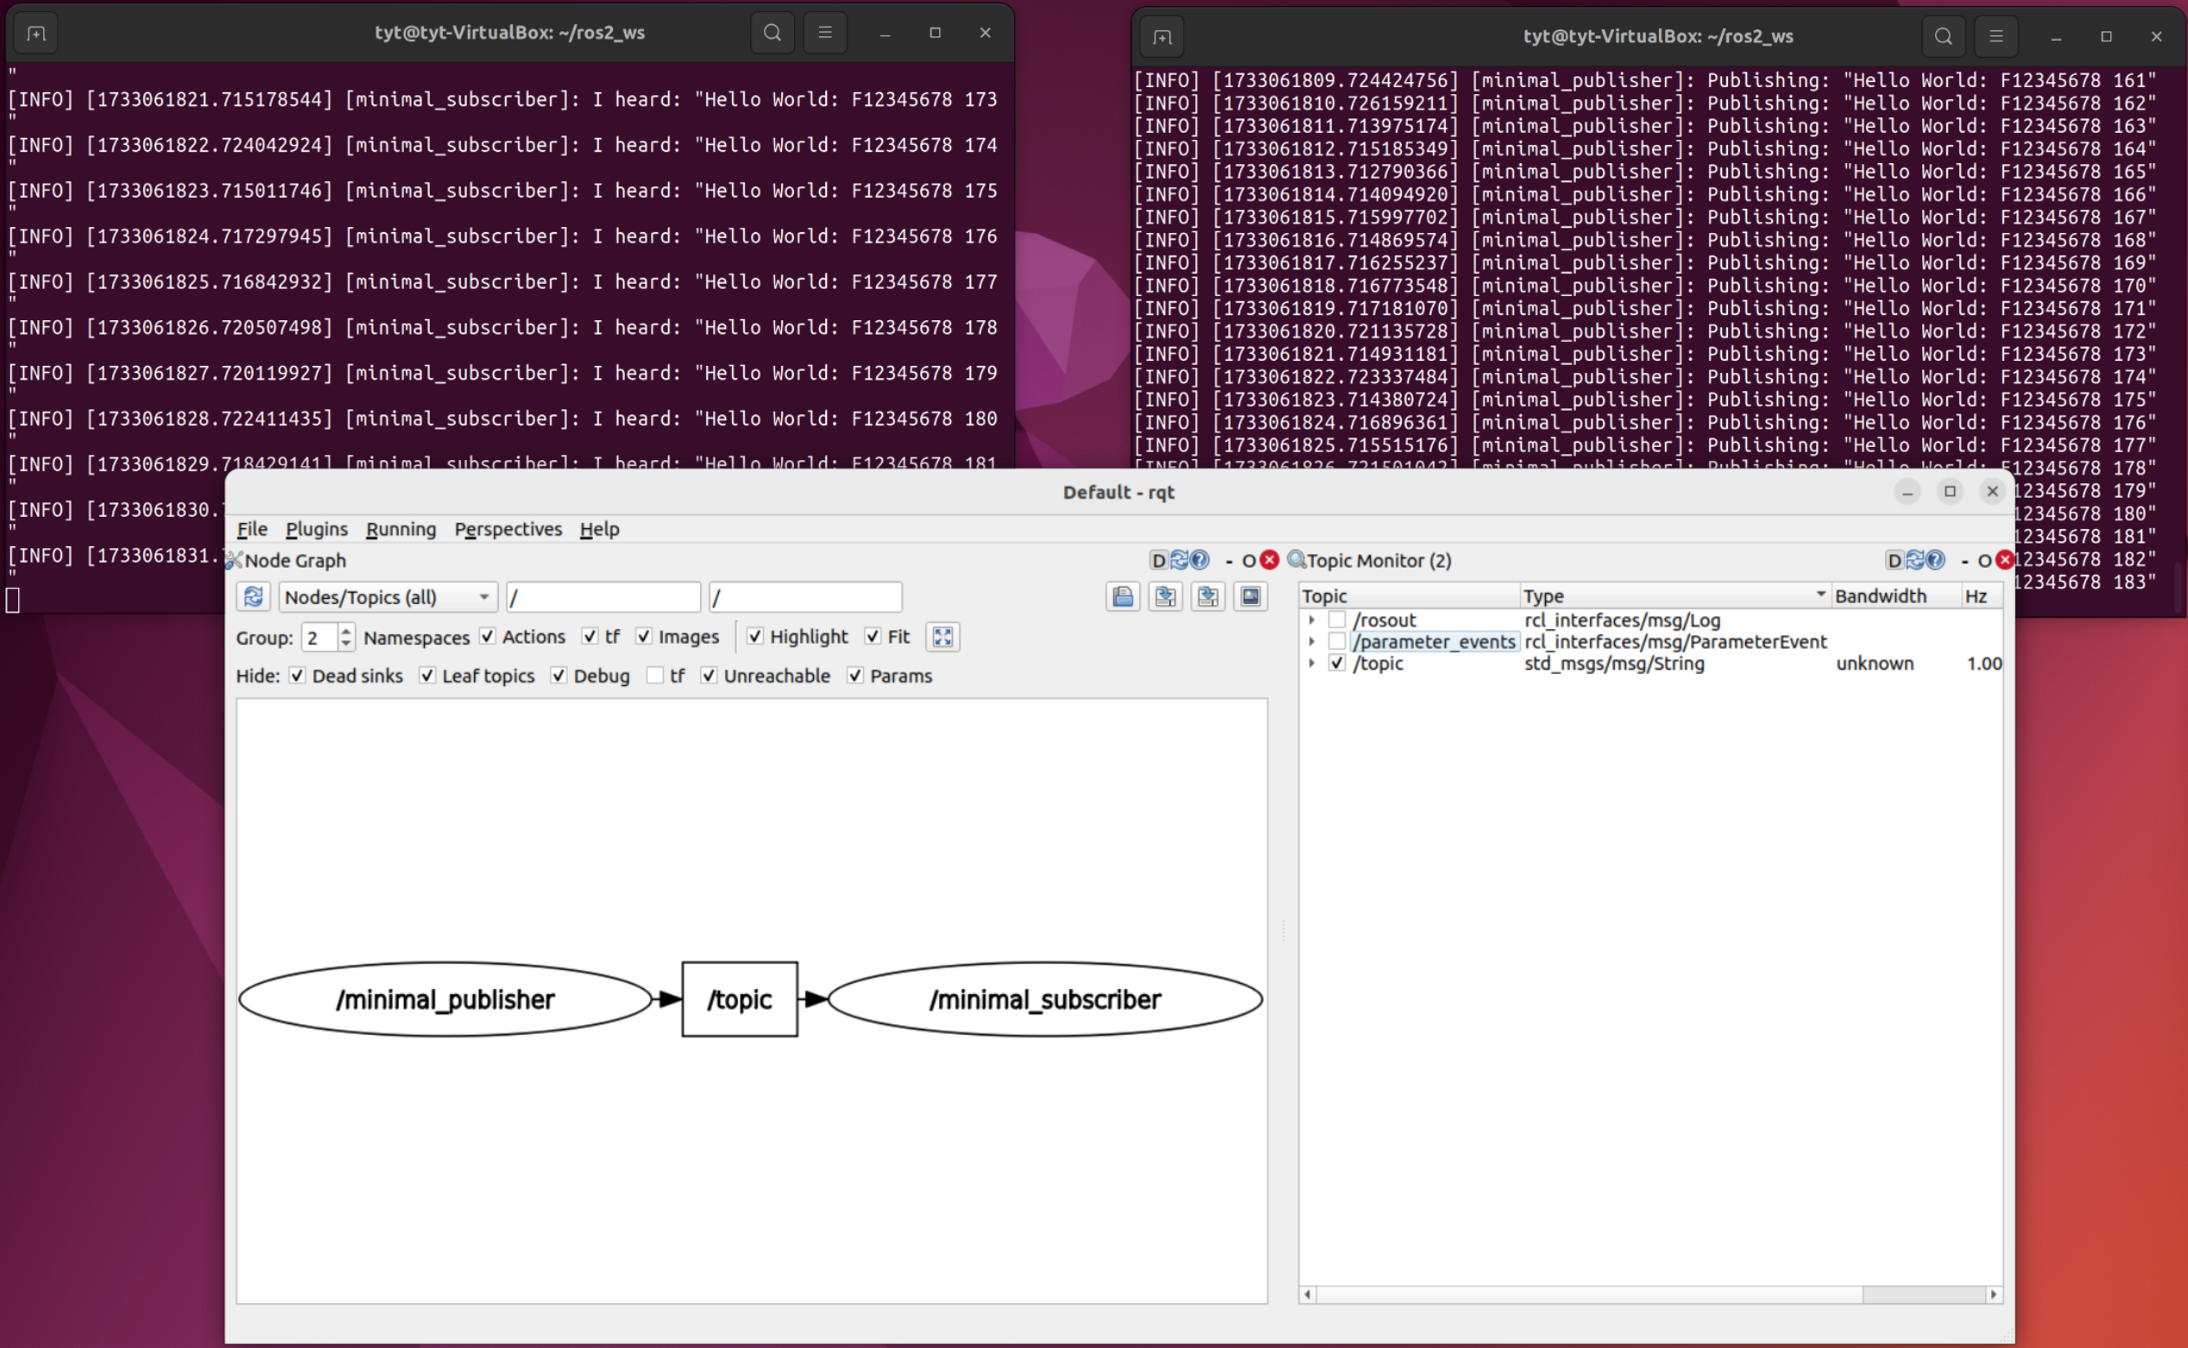
Demo
截圖須包含以下兩項檢查項目
1. Put your Student ID as the message
2. Change the data rate to 1Hz

Slide 22
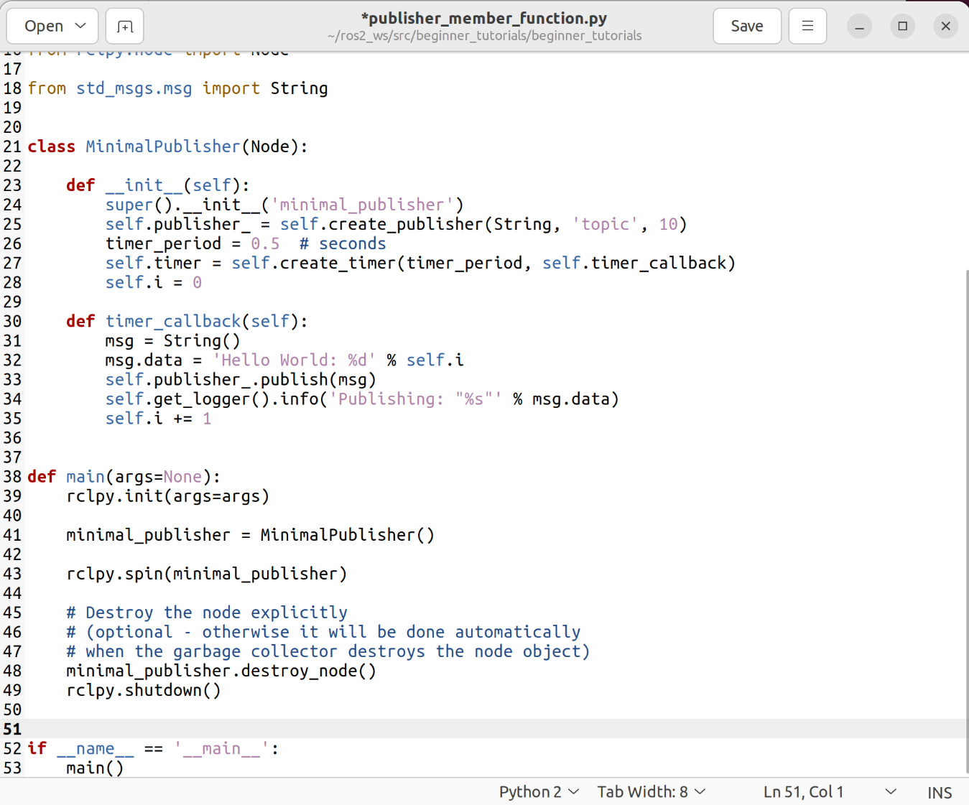
Hint: Modify “publisher_member_function.py”

Slide 23
Thanks

